Slide 1
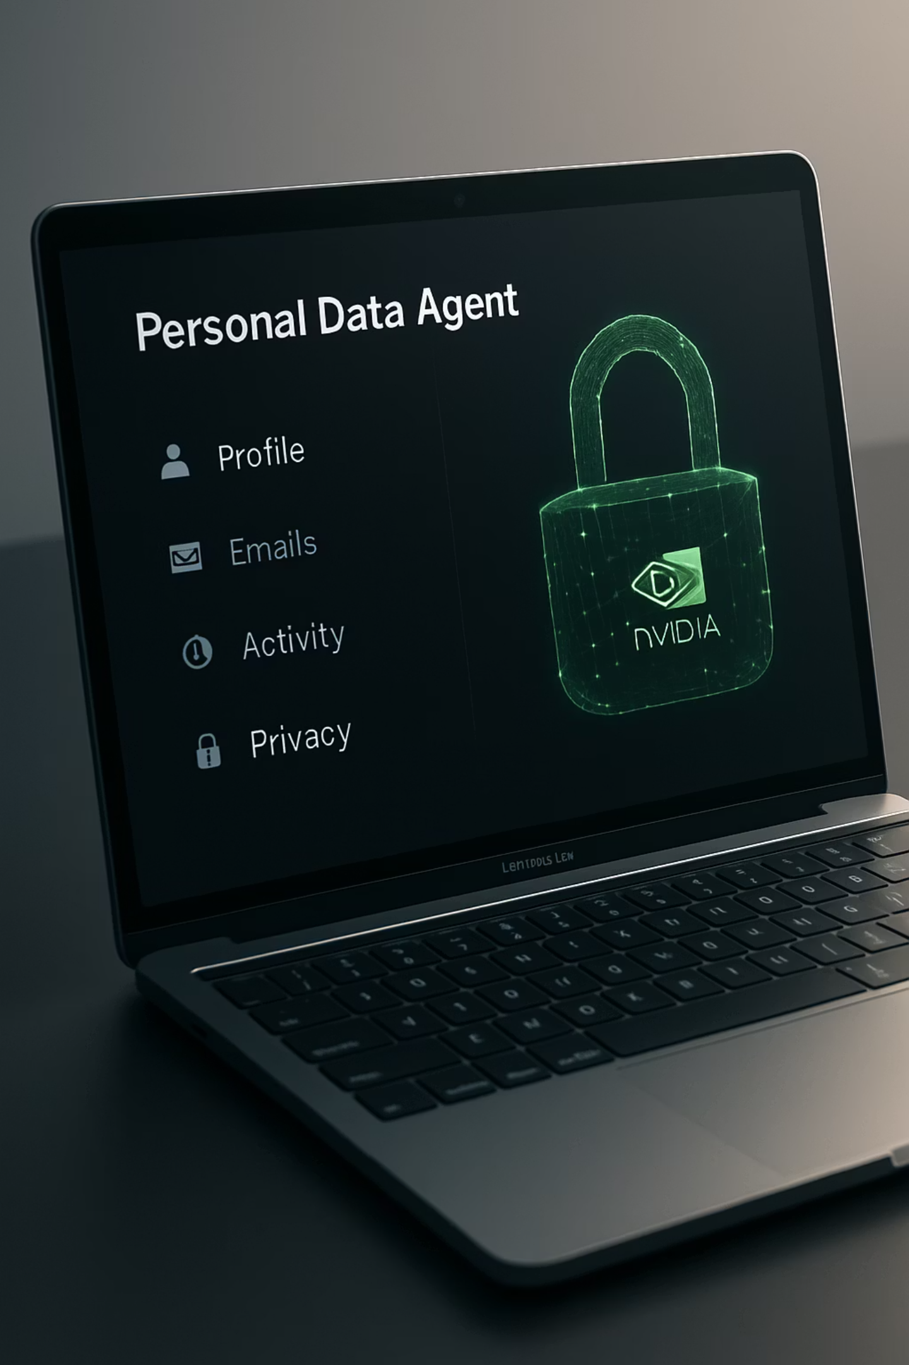
Hushh × NVIDIA
Project JENSEN
The Personal Data Agent + Expert Marketplace
Date: July 31, 2024 • Presenter: Manish Sainani, Founder — Hushh
Confidential — Hushh × NVIDIA Partnership Pre-Read

Slide 2
The One Ask
Green-light "Project JENSEN" (90-day MVP)
Enable Privacy-First Operation
Edge-to-cloud architecture (RTX ↔ DGX) with consent-driven processing
Co-build Hushh Personal Data Agent (Financial + Lifestyle) on NVIDIA AI stack
Launch Expert Marketplace
Align on Go-to-Market
"Train the human + the AI" with verified professional guidance
Co-sell motion and GTC showcase opportunity
This is a single high-leverage initiative: build, optimize, and go to market together with a shared vision for privacy-first AI.
Confidential — Hushh × NVIDIA Partnership Pre-Read

Slide 3
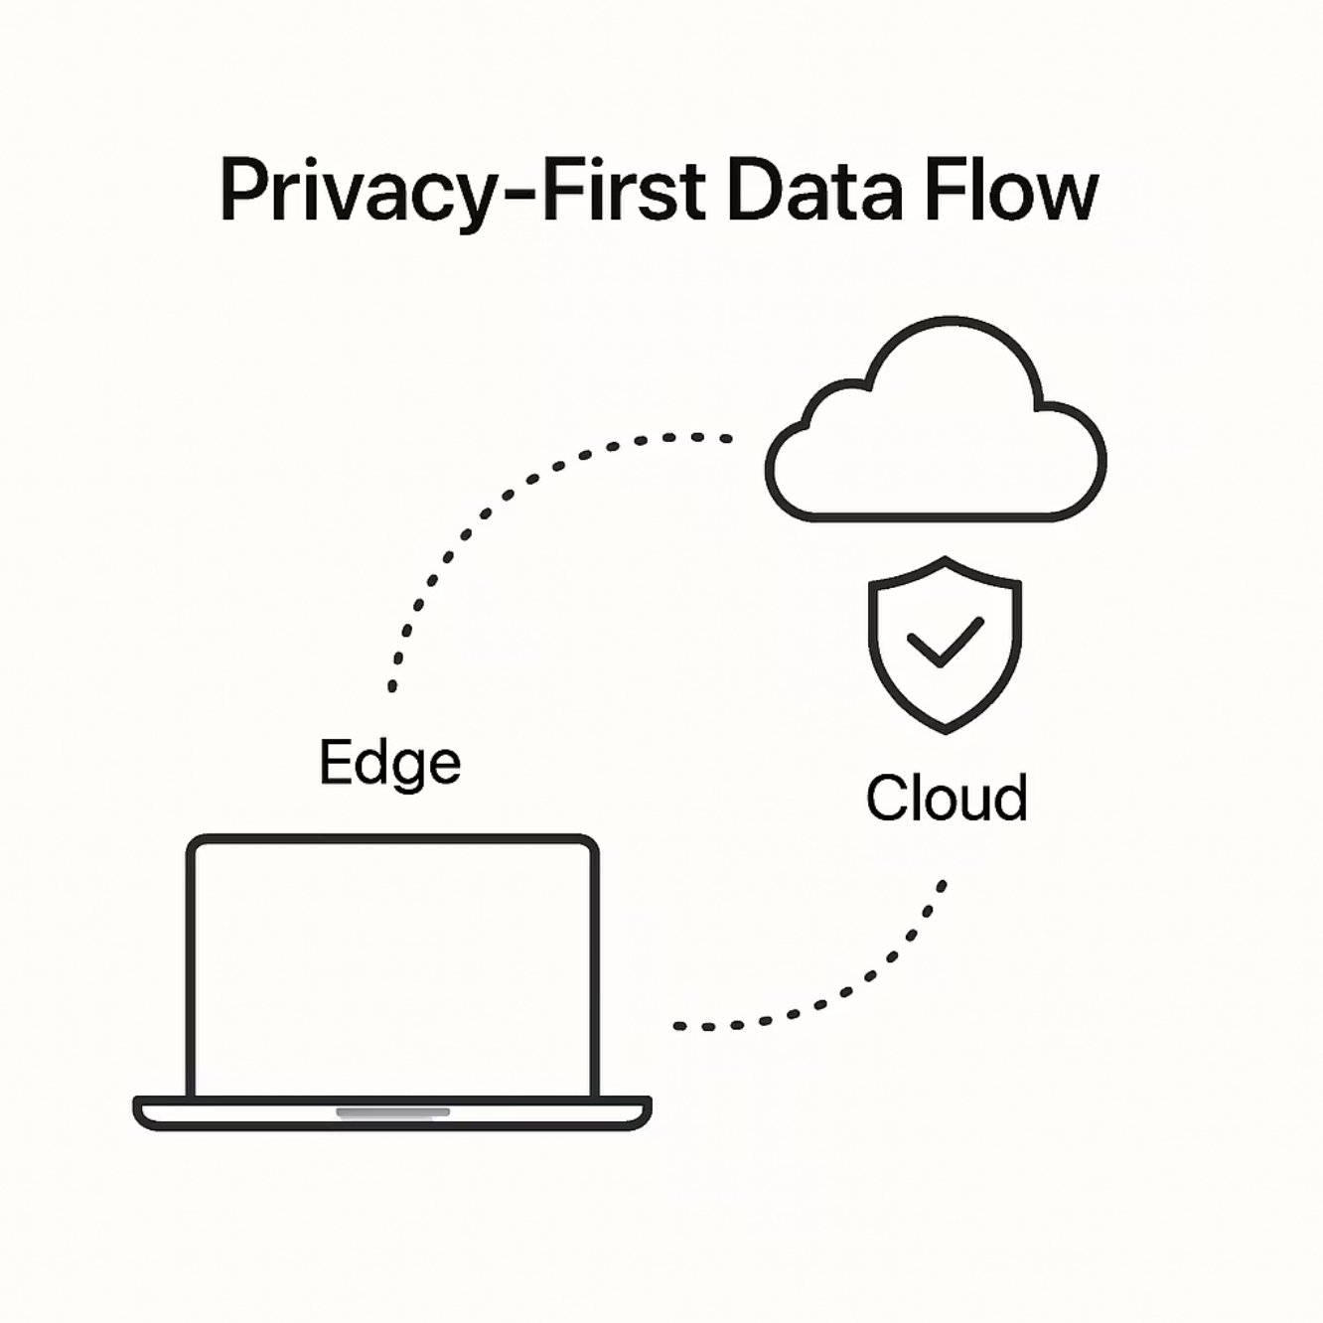
Why Now
Strategic Rationale
Users demand trust
"Your data. Your business." → consent, control, and value creation without compromising privacy
Agent epoch has arrived
Daily, task-level AI requires low-latency, secure compute with seamless UX
Edge + Cloud is the right substrate
RTX AI PCs + DGX Cloud enable private agents with superior performance
Category creation opportunity
Expert-in-the-loop agents set the gold standard for responsible AI
Confidential — Hushh × NVIDIA Partnership Pre-Read

Slide 4
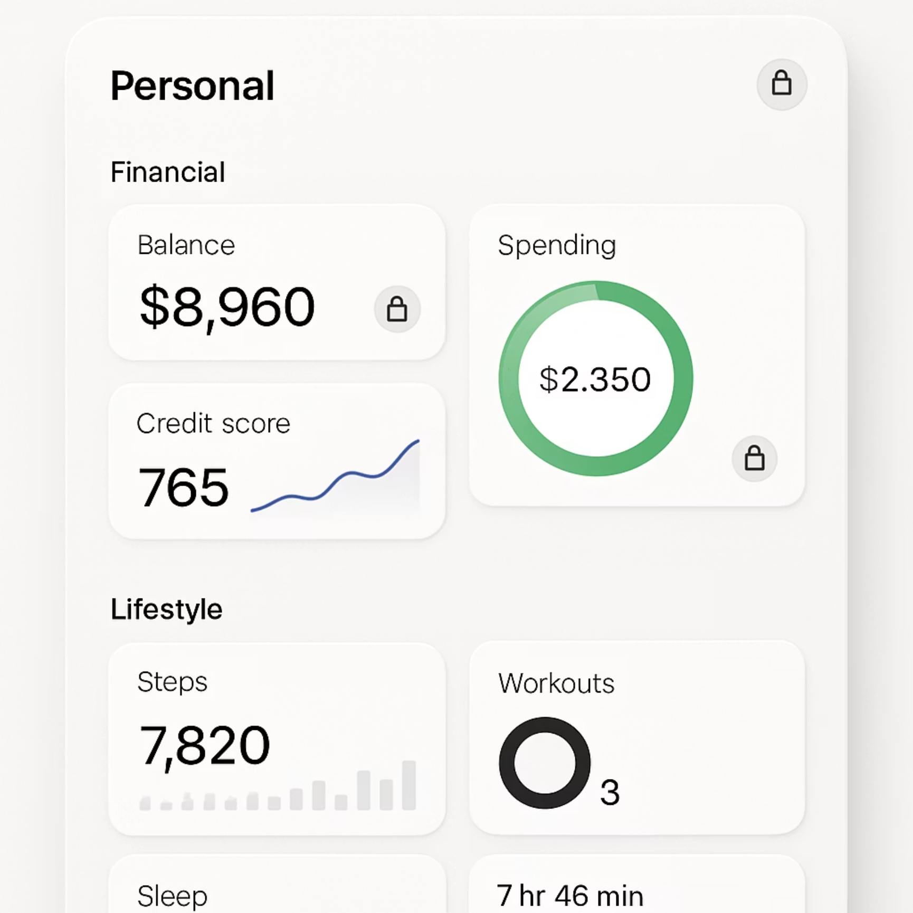


What We're Building
MVP Scope
Personal Data Agent connecting the user's most valuable data to act with consent:
Financial Agent
Daily brief with portfolio insights
Risk exposures and stress-tests
Tax-aware planning
Compliant audit trails
Lifestyle Agent
Trip/event orchestration
Commerce assistant
Household operating system
Subscription management
Expert Marketplace
Licensed advisors & concierges deliver playbooks the agent can execute, creating a human-AI hybrid experience
Confidential — Hushh × NVIDIA Partnership Pre-Read

Slide 5
Product Outcomes
User Value
2s
60%
24/7
100%
Speed to Clarity
Task Automation
Continuous Learning
Trust by Design
Immediate answers for routine financial and lifestyle queries, eliminating research time
Percentage of repetitive tasks executed safely with user approval
Experts teach users and tune their agents over time, creating compounding value
Local processing by default; cloud when needed; complete audit trail for peace of mind
Value accrues daily; trust compounds via transparency
Confidential — Hushh × NVIDIA Partnership Pre-Read

Slide 6

Architecture Overview
NVIDIA Stack
Models, serving, and acceleration
Hushh Flow
Orchestration, tasks, audit trail
Hushh Agent
Financial and lifestyle co-pilots
Hushh Vault
Encrypted KB with consent ledger
Hushh Link
Secure data connectors for sources
Hushh Stack
NVIDIA Stack
Link: Secure data connectors (finance, work, lifestyle)
NeMo + Guardrails: Domain-tuned LLMs, safe policies
Vault: Encrypted personal knowledge base + consent ledger
Riva: Low-latency ASR/TTS for hands-free use
Agent: Financial/Lifestyle co-pilots (tools, memory, approvals)
Triton + TensorRT-LLM: Efficient, scalable serving
Flow: Orchestration, tasks, audit trails
RTX / Jetson / DGX: On-device ↔ cloud acceleration
Confidential — Hushh × NVIDIA Partnership Pre-Read

Slide 7
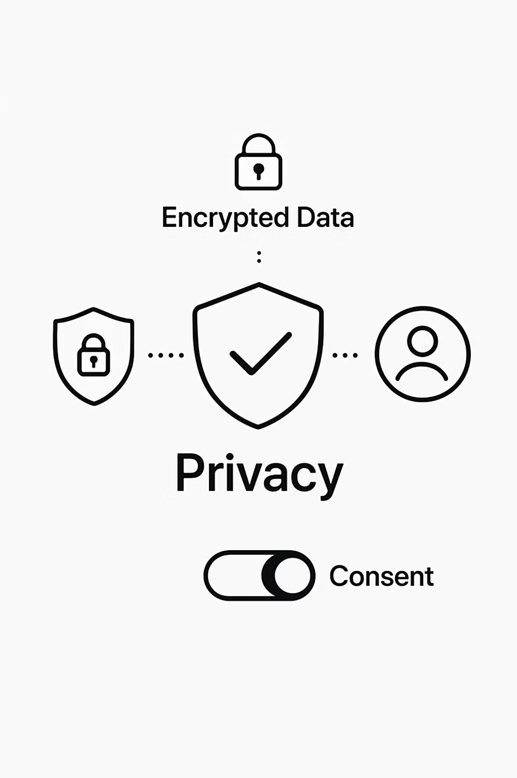
Privacy & Compliance
Hard Requirements
Consent-First
Granular permission scopes, revoke anytime, immutable consent receipts
End-to-End Encryption
Encrypted in rest/transit; encrypted-in-use where available (confidential compute)
Federated Learning
Aggregate model updates, never raw personal data leaves the device
Enterprise Controls
SSO/RBAC, DLP patterns, SOC2/ISO roadmap, comprehensive audit trails
We align with enterprise security expectations and regulatory requirements while maintaining an elegant user experience.
Confidential — Hushh × NVIDIA Partnership Pre-Read

Slide 8
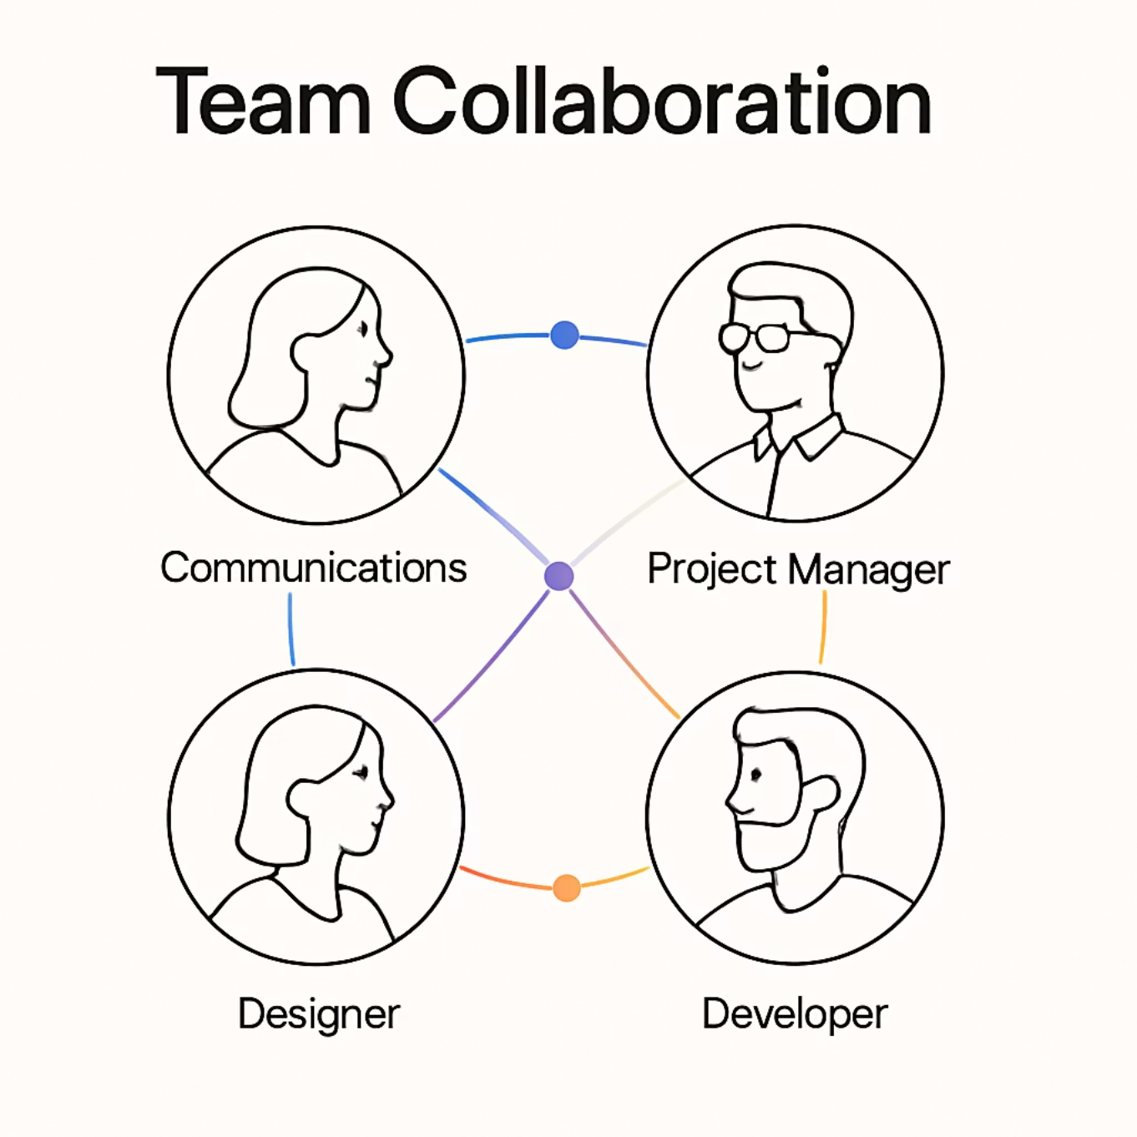
The Ask: People & Expertise
We request NVIDIA expert allocation for the 90-day MVP development:
1
Solution Architects
2× specialists for LLM optimization and inference acceleration
2
NeMo/Guardrails Specialist
Fine-tuning, retrieval enhancement, policy implementation
3
Riva Specialist
ASR/TTS integration, latency tuning for voice interactions
4
Triton Specialist
Named points of contact with weekly engineering sync meetings to ensure alignment and progress.
Batching optimization, autoscale configuration, canary rollout
Confidential — Hushh × NVIDIA Partnership Pre-Read

Slide 9
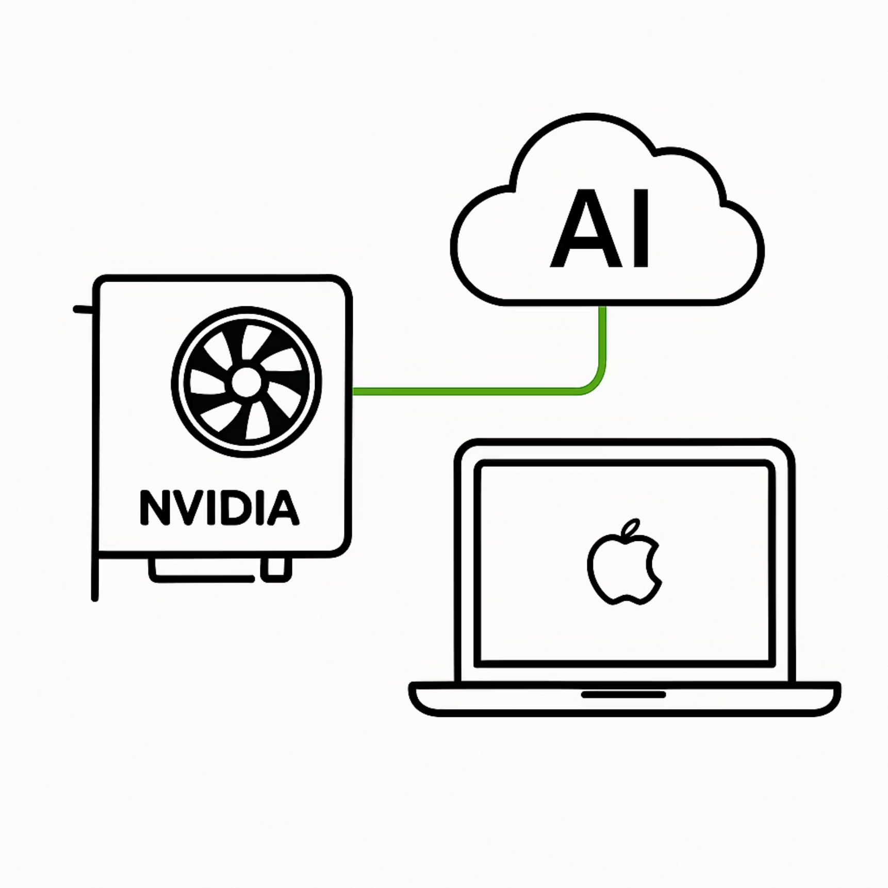
The Ask: Platform & Credits
AI Enterprise Toolchain
Access to NeMo, Riva, Triton, and TensorRT-LLM for development and optimization
DGX / DGX Cloud
Credits for training and evaluation sprints to accelerate development
RTX AI PC Guidance
Reference architecture for on-device mode optimization
Jetson Dev Kits
For optional branch/edge pilots and specialized deployments
This comprehensive platform access de-risks our development timeline and showcases NVIDIA's end-to-end capabilities while enabling a premium user experience.
Confidential — Hushh × NVIDIA Partnership Pre-Read

Slide 10
The Ask: Programs & GTM
Fast-Track Program Access
Co-Sell Alignment
Showcase Opportunities
Lighthouse Introductions
Finance, enterprise, and GCC routes to market with coordinated messaging
Inception + NPN ISV; listing as "Accelerated by NVIDIA" to establish credibility
GTC session + joint PR/case study to highlight our partnership
2–3 RIAs/family offices; 1 luxury concierge partner to validate market fit
"Buy, build, and sell together" from Day 0
Confidential — Hushh × NVIDIA Partnership Pre-Read

Slide 11





90-Day Build Plan
Sprint 0
Wk 0–1: security, sandboxes, stories
Sprint 1
Wk 2–5: Link, Vault, retrieval, Daily Brief
Sprint 2
Wk 6–9: Marketplace alpha, Playbooks, Riva
Sprint 3
Wk 10–13: 50-user pilot, compliance, GTC demo
Sprint 0 (Weeks 0–1)
Sprint 2 (Weeks 6–9)
Security review, sandboxes live, top-20 user stories defined
Marketplace alpha (10 experts), Playbooks, Riva v0, Triton v1
Sprint 1 (Weeks 2–5)
Sprint 3 (Weeks 10–13)
Link + Vault + retrieval; Daily Brief v0; Trip Plan v0 (RTX & cloud)
50-user pilot, compliance dashboards, GTC-ready demonstration
Milestone-based development with clear go/no-go gates at each sprint boundary to ensure quality and alignment.
Confidential — Hushh × NVIDIA Partnership Pre-Read

Slide 12
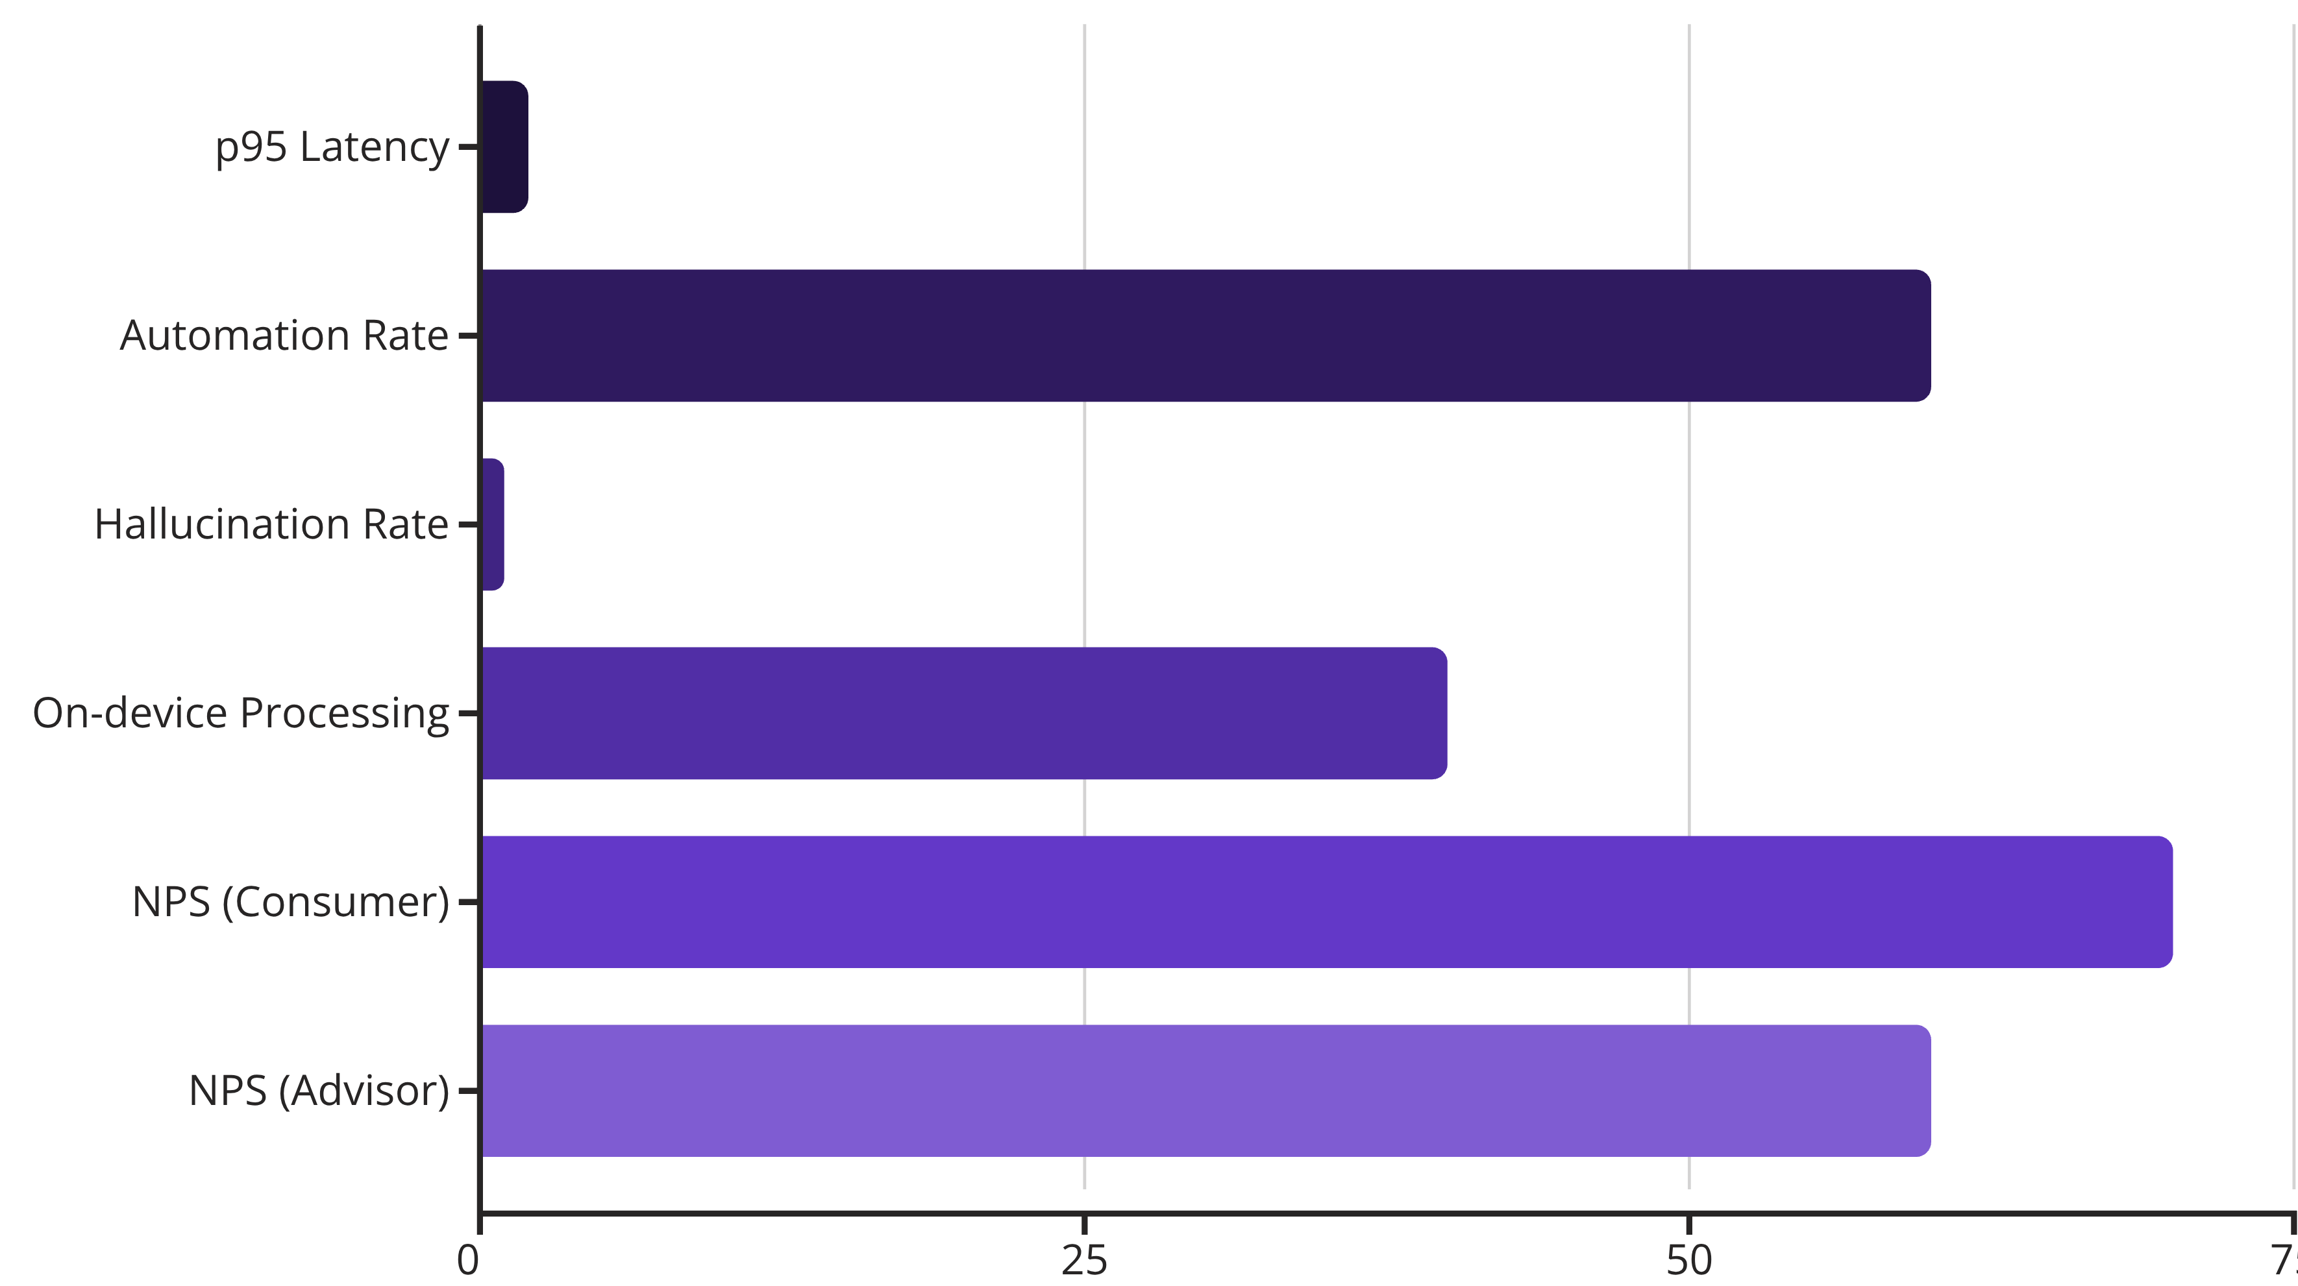
Success Metrics
KPI Targets
Performance Metrics:
Adoption Metrics:
p95 latency: < 2s for common queries
On-device processing: ≥ 40% daily interactions
Automation rate: ≥ 60% routine tasks with approval
NPS: ≥ 70 (consumer), ≥ 60 (advisor/enterprise)
Hallucinations: < 1% on grounded finance answers
Marketplace: 30 vetted experts; 50% users complete a session in 90 days
Confidential — Hushh × NVIDIA Partnership Pre-Read

Slide 13
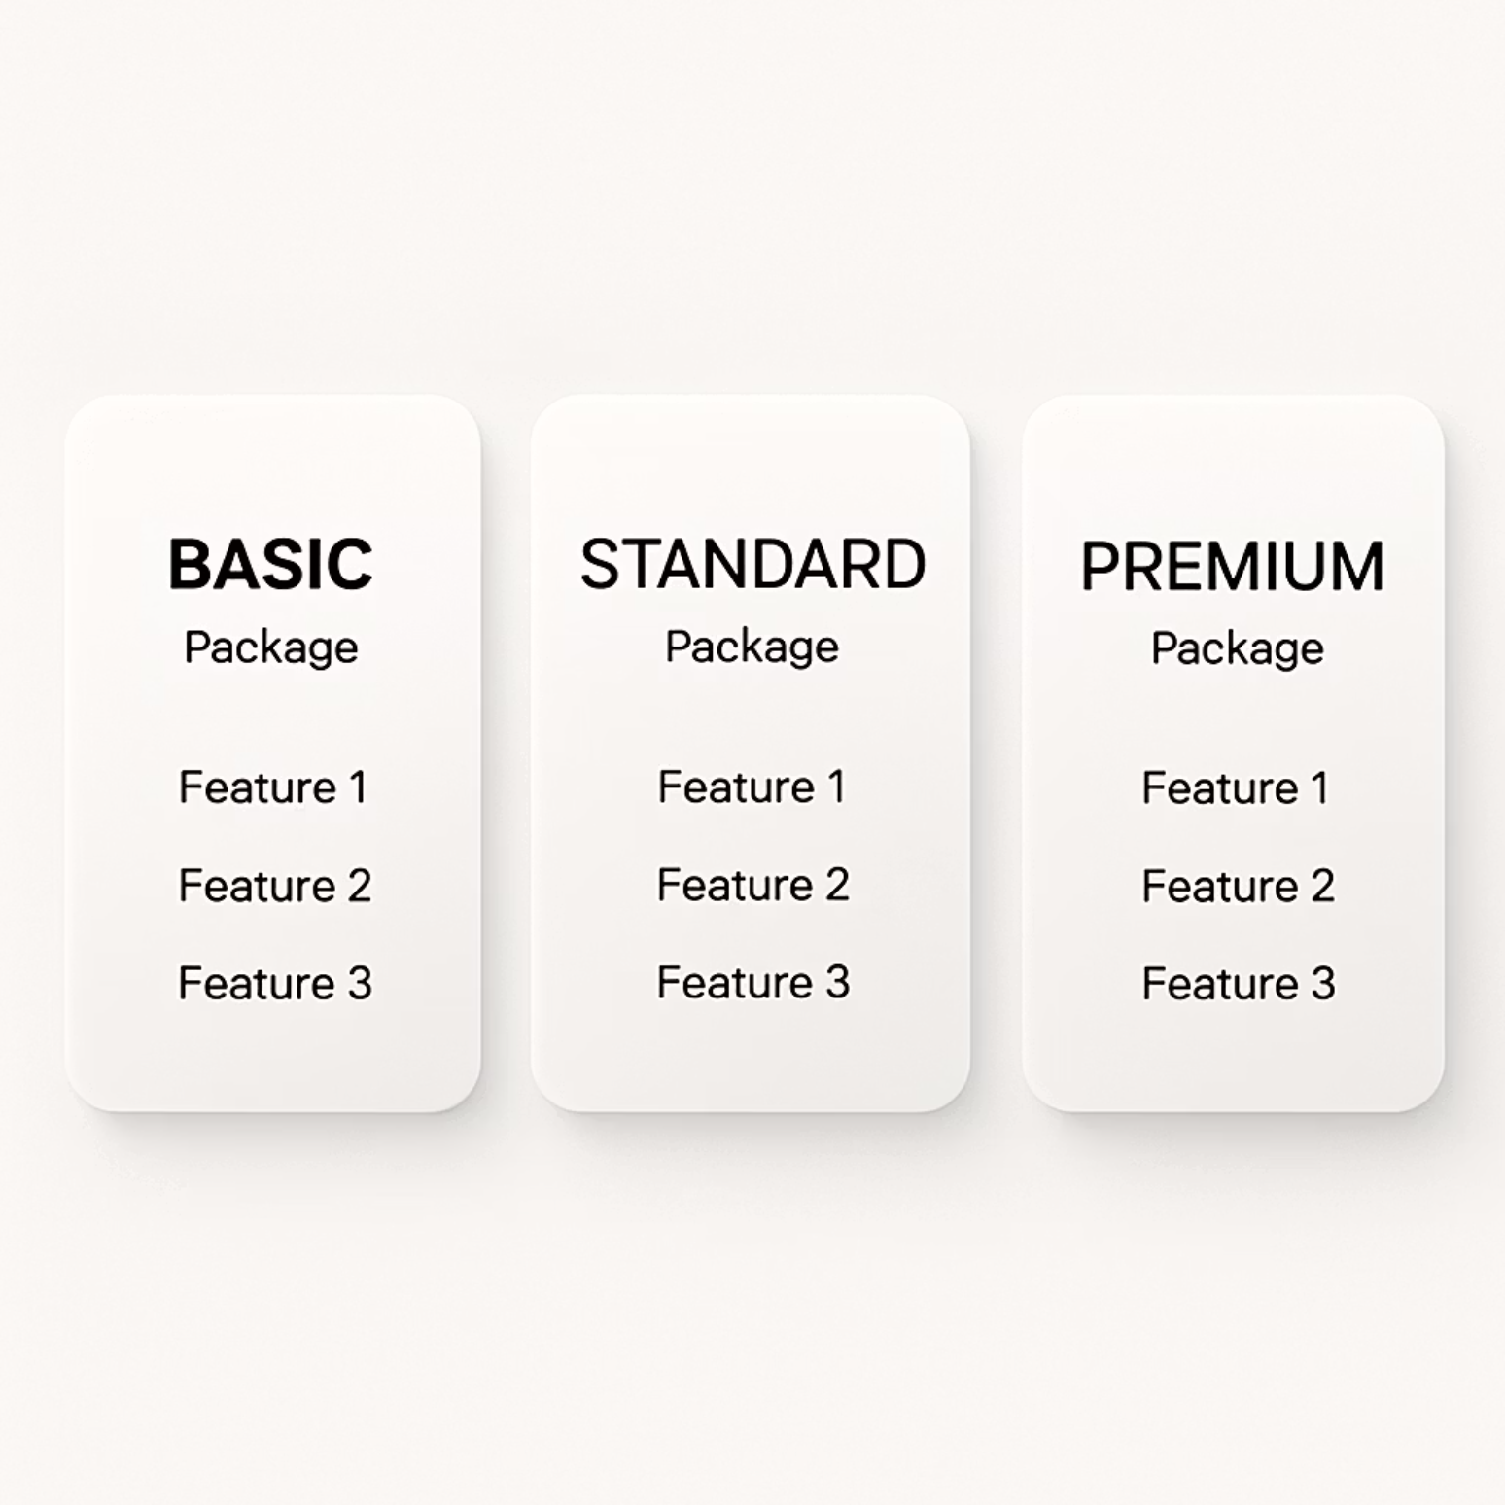



GTM & Packaging
Market Segments
Personal (Prosumer)
Individual users seeking privacy-first data management and AI assistance
Pro (Advisor)
Financial advisors, concierges, and other professional service providers
Enterprise (Firms)
RIAs, family offices, and luxury service organizations
Package Tiers
Personal (RTX-enhanced)
Local-first processing with cloud offload capabilities
Pro
+ Expert Marketplace access, advanced data connectors
Enterprise
Admin controls, on-prem Triton option, SLAs, enhanced auditing
Co-Sell Assets
Joint one-pager with value proposition
Interactive demonstration sequence
Transparent pricing structure
Comprehensive security FAQ
Initial focus on RIAs/family offices and luxury concierge partners as our primary go-to-market targets.
Confidential — Hushh × NVIDIA Partnership Pre-Read

Slide 14

Risks & Mitigations
Integration Sprawl
Risk: Too many connectors leads to quality issues
Mitigation: Start with 6 high-yield connectors; defer long-tail integrations
Advisor Compliance
Risk: Regulatory concerns with financial advice
Mitigation: Read-only defaults; licensing verification; clear disclosures
Latency/Cost Balance
Risk: Performance vs. economics tradeoffs
Mitigation: Hybrid approach: RTX local + Triton batching/cloud bursts
AI Safety
Risk: Hallucinations or inappropriate recommendations
Mitigation: Guardrails + retrieval; human-approval loop for consequential actions
We keep the surface area small with safety defaults enabled, ensuring user trust while maintaining elegant simplicity.
Confidential — Hushh × NVIDIA Partnership Pre-Read

Slide 15
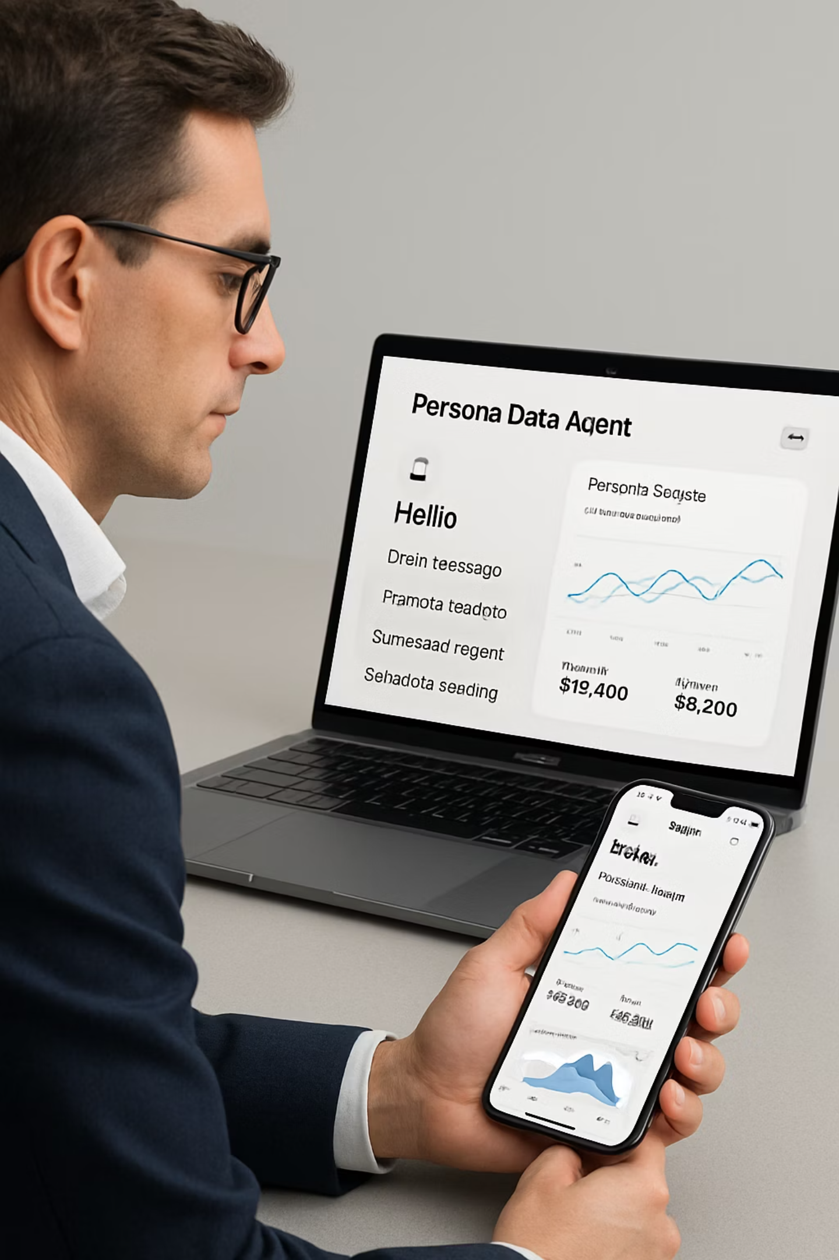
Day-in-the-Life
Maya, Registered Investment Advisor
Morning Workflow
Evening at Home
Daily Brief flags duration drift, single-name risk, tax-loss opportunities
Lifestyle Agent finalizes family trip via Riva voice interface
Agent drafts hedges, harvest plan, client letters → Maya approves
System logs product warranties from recent purchases
Marketplace auto-books a tax pro to review the plan
Privacy maintained: Sensitive steps processed locally on RTX; heavy computational tasks burst to DGX — all with explicit consent
Human-in-the-loop, compounding value, zero surprise — trust by design
Confidential — Hushh × NVIDIA Partnership Pre-Read

Slide 16


Decision & Next Steps
Decision Today
Leave With
Approve Project JENSEN 90-day MVP with NVIDIA staffing, platform access, and GTM plan.
01
Named Leads
Hushh × NVIDIA points of contact + shared communication channel
02
Environment Access
DGX/RTX, AI Enterprise platform credentials
03
Pilot Criteria
Success metrics + lighthouse customer short list
04
GTC Planning
Placeholder for showcase and announcement
Clear ownership and immediate momentum will ensure we hit our 90-day MVP targets and establish a foundation for long-term partnership success.
Confidential — Hushh × NVIDIA Partnership Pre-Read

Slide 17

Appendix
Supporting Information
Confidential — Hushh × NVIDIA Partnership Pre-Read

Slide 18
Connector Pack
Phase 1 Integrations
Finance
Work
Custodians (files/API)
Email integration
Broker statements
Calendar synchronization
Bank/credit accounts
Document storage
Tax documents
Cloud drive access
Pricing/news feeds
Slack/Teams messaging
Lifestyle
Identity & Consent
Travel (air/hotel/loyalty)
KYC/ID verification vault
E-commerce receipts
Consent receipts
Subscription management
Shareable data cards
Maps/location services
Permission management
Vendor relationships
These initial connectors represent the highest-value data sources for our target users, providing comprehensive coverage while maintaining manageable integration complexity.
Confidential — Hushh × NVIDIA Partnership Pre-Read

Slide 19





Ownership Matrix
RACI Responsibility Assignment
Hushh Product
NVIDIA GTM
Hushh Platform
NVIDIA Enablement
Hushh Responsibilities
NVIDIA Responsibilities
Product strategy and user experience design
NeMo/Riva/Triton/TensorRT enablement
Link/Vault/Agent/Flow component development
RTX/Jetson/DGX technical guidance
Expert Marketplace operations
Confidential compute implementation path
Enterprise controls implementation
Co-sell and channel management
User support and success management
GTC showcase and lighthouse introductions
Clear ownership with collaborative touchpoints ensures efficient execution and prevents misalignment during the development process.
Confidential — Hushh × NVIDIA Partnership Pre-Read

Slide 20
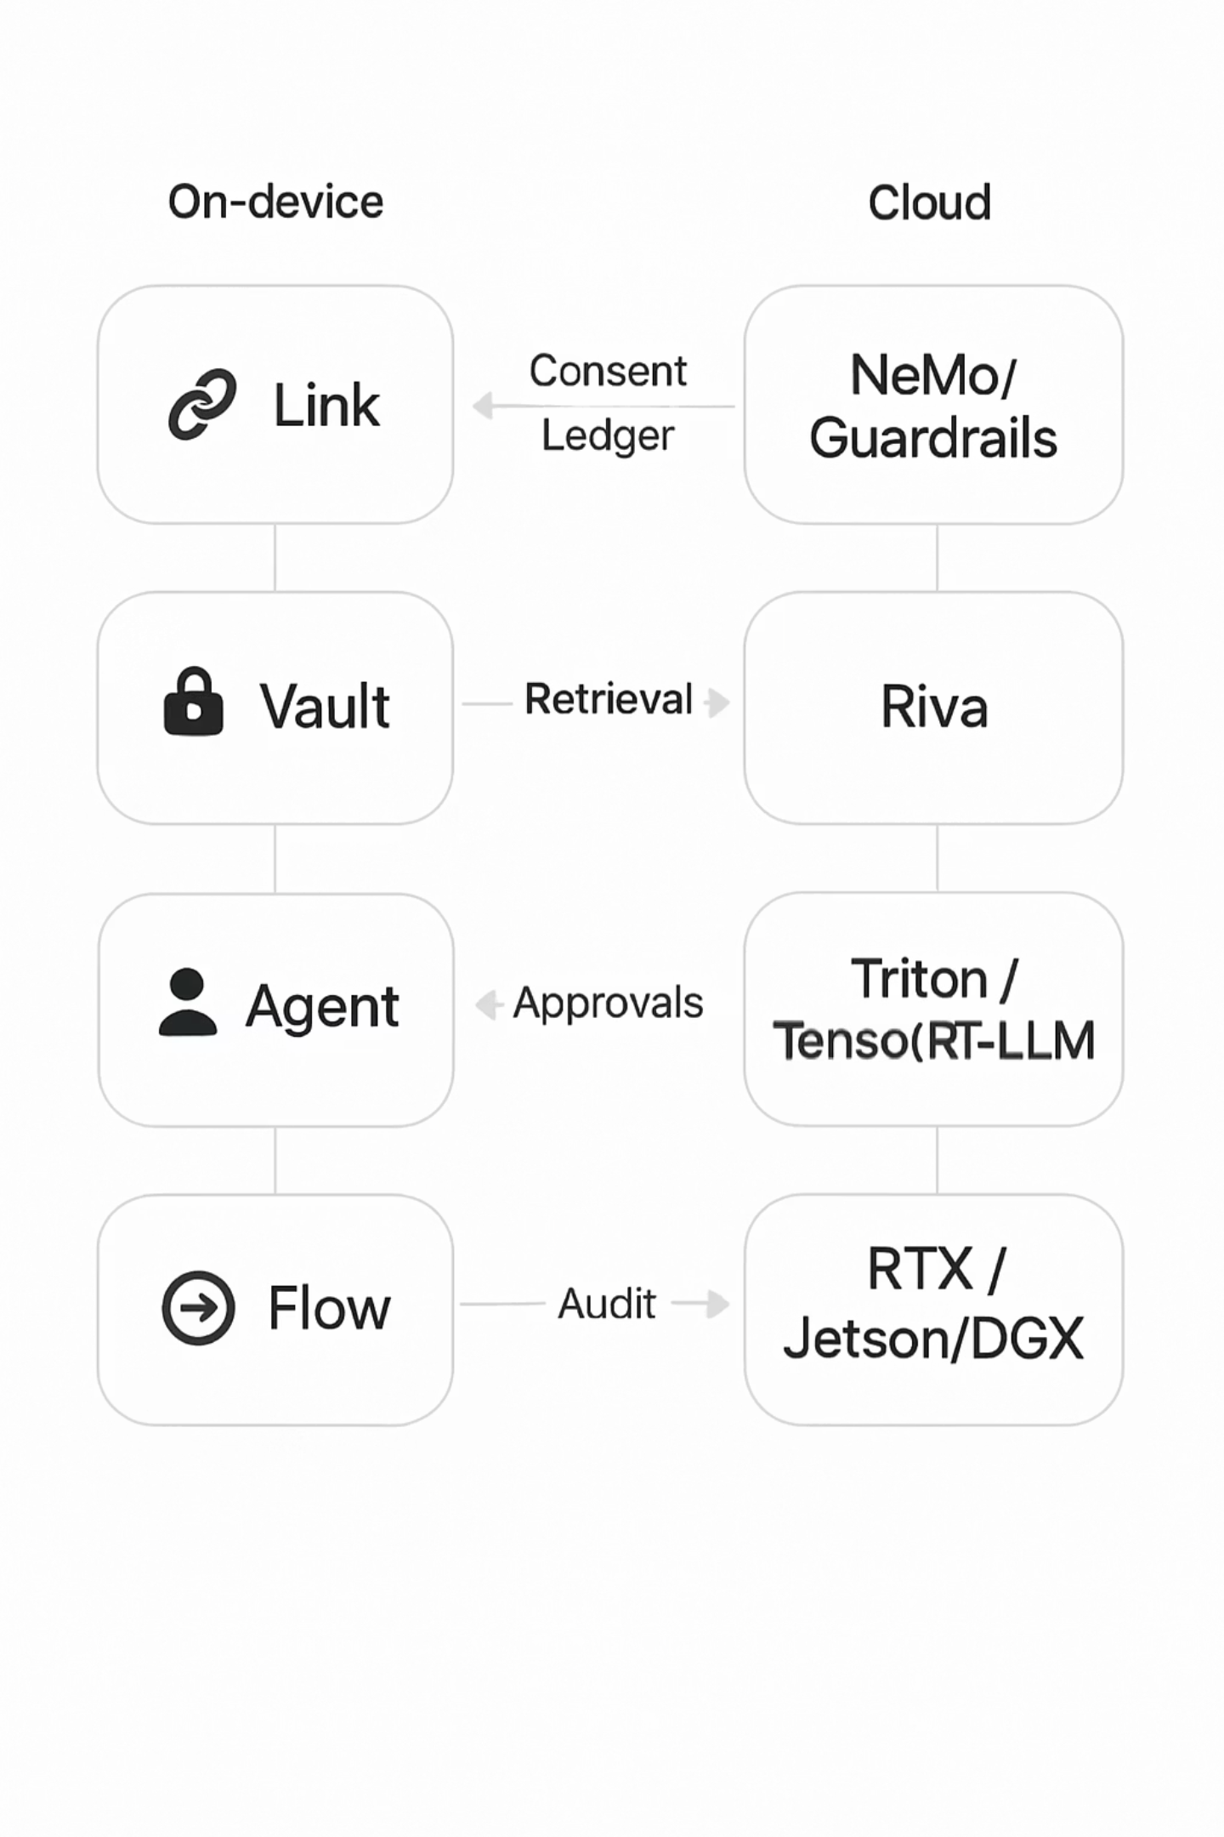
Visual Architecture
Detailed System Design
This layered architecture maps Hushh components (Link, Vault, Agent, Flow) to corresponding NVIDIA technologies (NeMo/Guardrails, Riva, Triton/TensorRT-LLM, RTX/Jetson/DGX), highlighting both on-device and cloud processing paths. The consent ledger serves as the foundation, ensuring all data access and processing follows user-approved parameters.
Key elements include the retrieval augmentation system for grounded responses, the approval workflow for consequential actions, and comprehensive audit trails for transparency and compliance.
Confidential — Hushh × NVIDIA Partnership Pre-Read

Slide 21
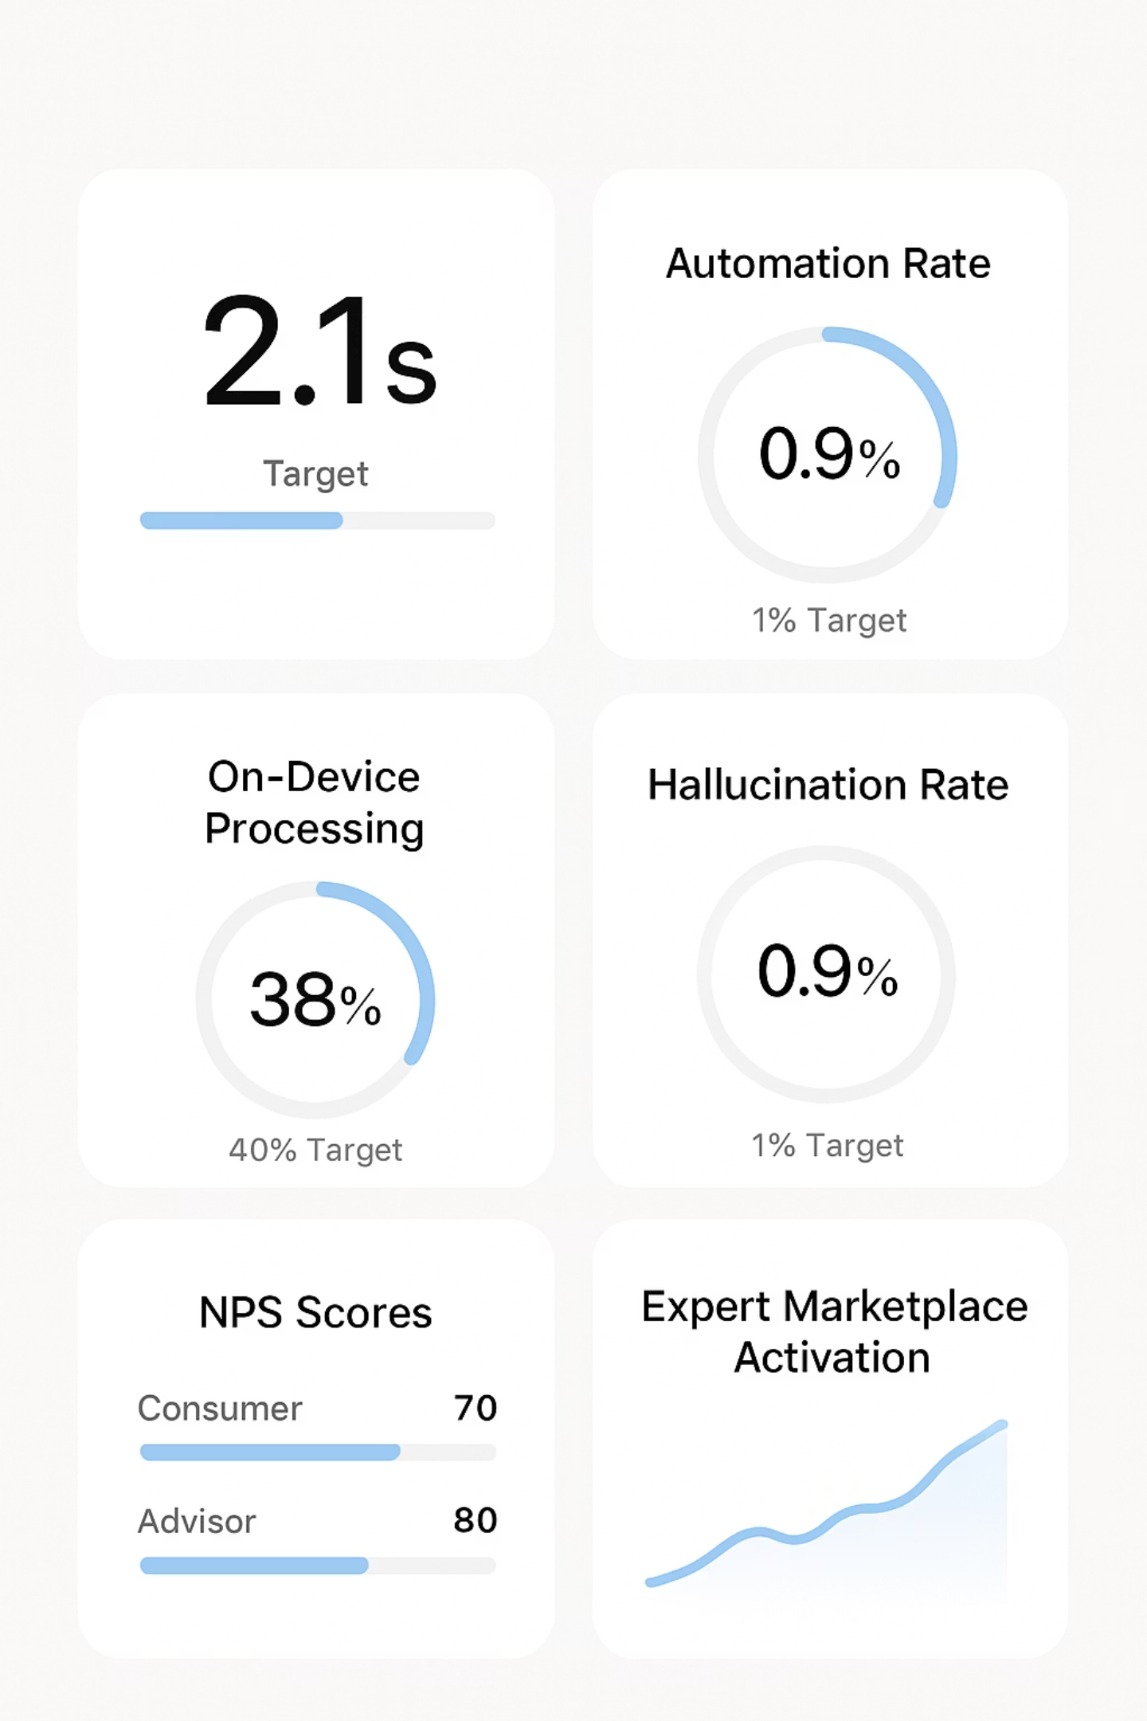
KPI Dashboard
Performance Monitoring
Performance
Efficiency
Satisfaction
p95 latency: < 2s
Automation rate: ≥ 60%
NPS (Consumer): ≥ 70
Hallucination rate: < 1%
On-device processing: ≥ 40%
NPS (Advisor): ≥ 60
Marketplace activation: 50%
This dashboard provides real-time visibility into system performance and user satisfaction metrics, enabling data-driven optimization and early identification of potential issues.
Confidential — Hushh × NVIDIA Partnership Pre-Read

Slide 22
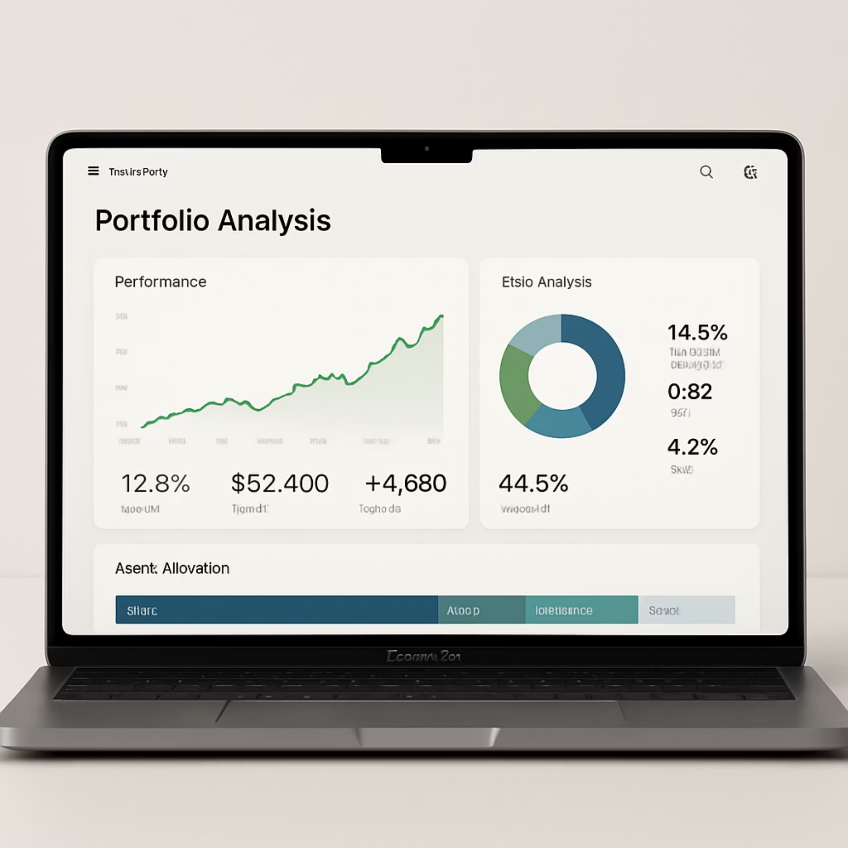
Financial Agent Features
Daily Financial Brief
AI-generated summary of portfolio performance, market movements, and actionable insights delivered each morning
Risk Exposure Analysis
Automated identification of concentration risk, correlation issues, and potential vulnerabilities across asset classes
Tax-Aware Planning
Proactive tax-loss harvesting recommendations and tax-efficient investment suggestions based on real-time portfolio analysis
Compliant Documentation
Automated generation of required regulatory disclosures and audit-ready documentation for all transactions and recommendations
The Financial Agent leverages privacy-first architecture to provide institutional-grade insights while keeping sensitive financial data secure. All recommendations include clear explanations and can be reviewed by human experts through the marketplace.
Confidential — Hushh × NVIDIA Partnership Pre-Read

Slide 23
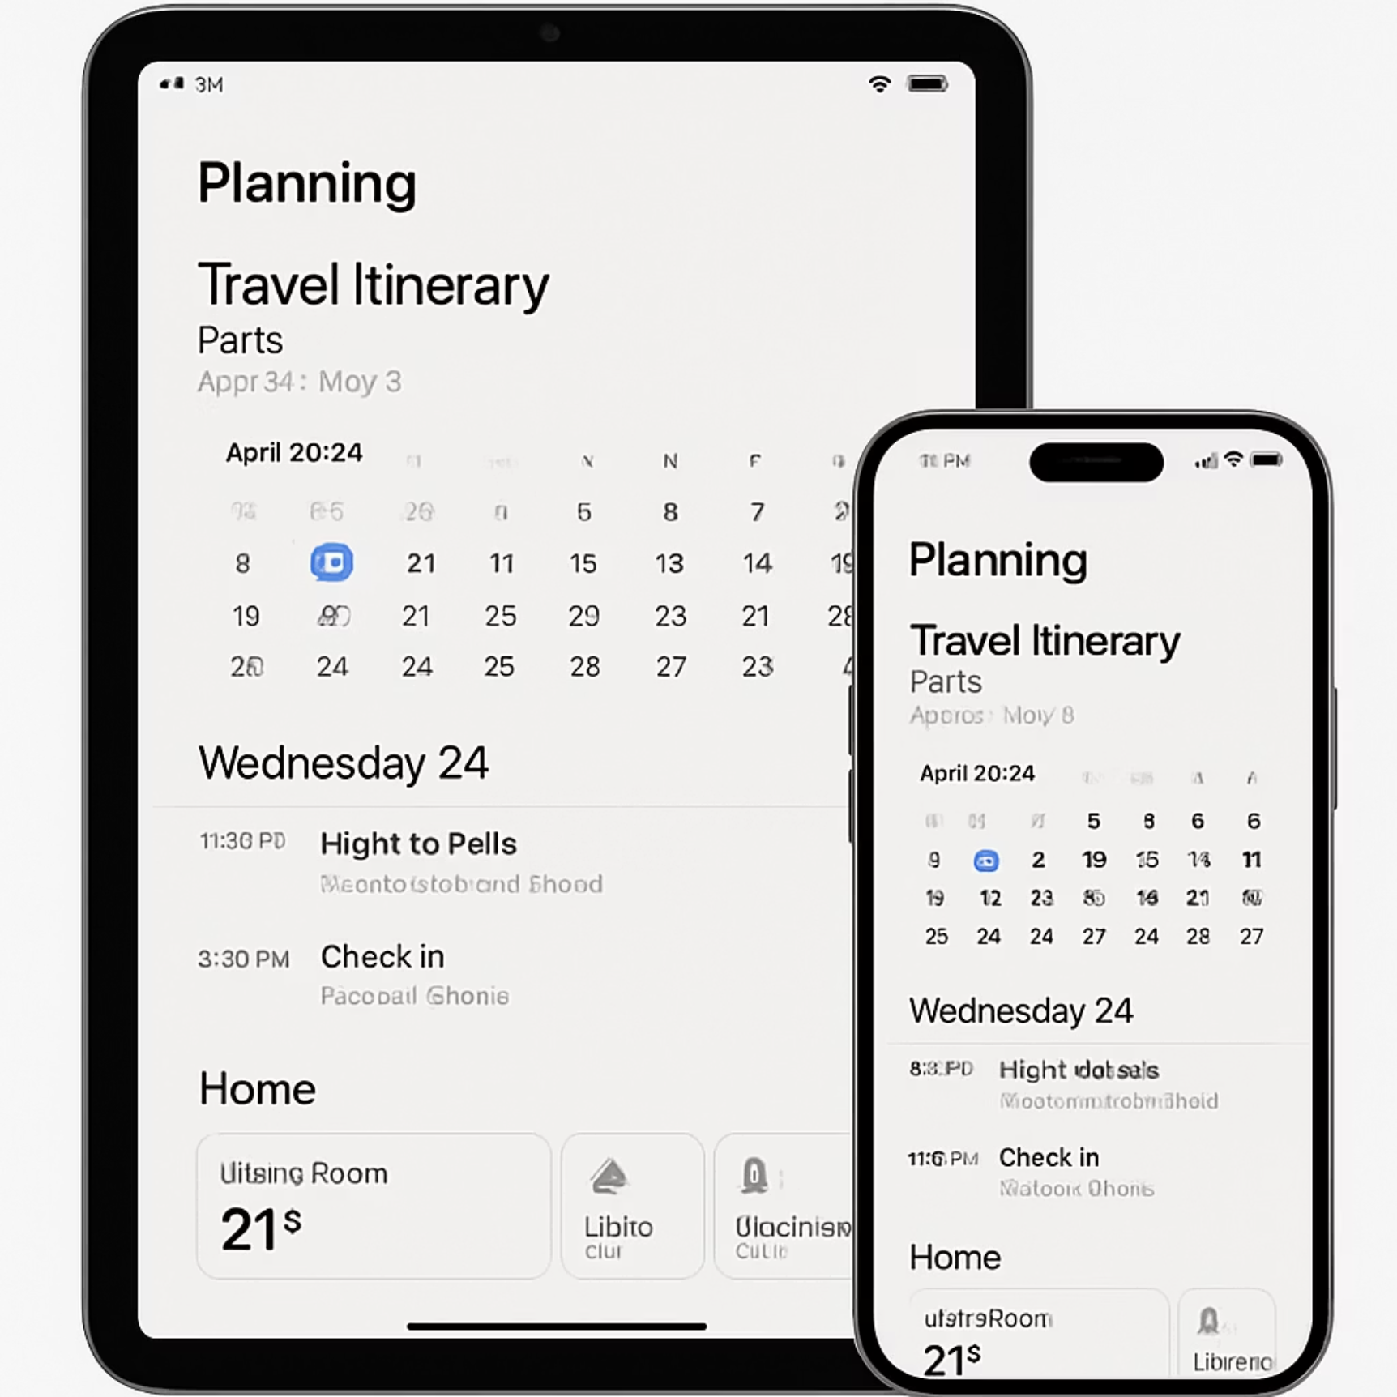
Lifestyle Agent Features
Trip Orchestration
End-to-end travel planning with AI-driven recommendations based on preferences, loyalty programs, and budget constraints
Commerce Assistant
Personalized shopping recommendations, price tracking, warranty management, and receipt organization
Household Operating System
Unified interface for managing home services, subscriptions, maintenance schedules, and family calendars
Voice-First Experience
Natural language interface powered by Riva for hands-free control and information access across all lifestyle domains
The Lifestyle Agent seamlessly connects personal preferences, calendar events, and external services to automate routine tasks while maintaining complete user control over sensitive information and decision-making.
Confidential — Hushh × NVIDIA Partnership Pre-Read

Slide 24
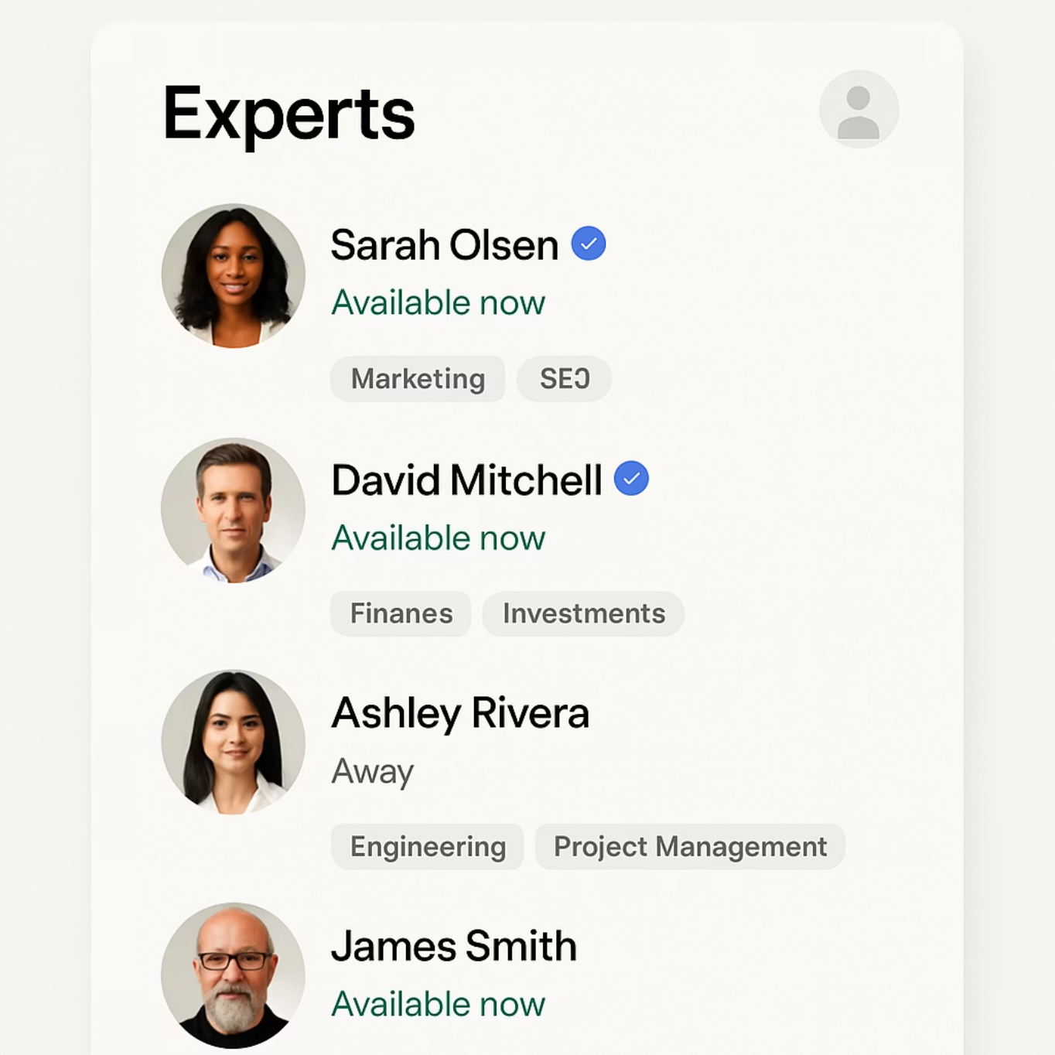
Expert Marketplace
Human-AI Collaboration
Key Features
Verified Credentials
All experts undergo rigorous verification of licenses, certifications, and professional background
Knowledge Transfer
Experts create reusable playbooks that can be executed by the agent, extending their expertise
Seamless Handoff
Intelligent routing of complex questions from AI to appropriate human experts when needed
Secure Collaboration
Privacy-preserving environment for sharing only relevant information with experts
The marketplace provides users with access to verified professionals who can review AI recommendations, provide specialized expertise, and create playbooks that the agent can execute.
The Expert Marketplace bridges the gap between AI capabilities and human expertise, ensuring users receive high-quality guidance while maintaining privacy and control over their personal data.
Confidential — Hushh × NVIDIA Partnership Pre-Read

Slide 25






Win-Win-Win Partnership
Hushh Wins
Accelerated development with best-in-class AI infrastructure
Users Win
Performance optimization
Privacy-first AI with performance that doesn't compromise security or control
Credibility enhancement
Go-to-market acceleration
Full data ownership
NVIDIA Wins
Transparent operation
Showcase for full-stack AI with privacy-preserving architecture
Expert guidance when needed
RTX/DGX utilization
NeMo/Riva/Triton adoption
Category-defining reference
Buy • Build • Sell Together
Confidential — Hushh × NVIDIA Partnership Pre-Read

